Slide 1

ECON 1BB3 – Introduction to Macroeconomics
Notes:
For people who are unemployed, it is bad (i.e. during a recession), but all unemployment is not necessarily bad for the economy as a whole

Slide 2
Statistics Canada divides the NON-INSTITUTIONAL adult population i(age > or = 15) nto three categories:
1. Employed – an individual who has spent time working at a paid job for some of the past week
2. Unemployed – an individual who is looking for work, able to work, and unable to find a job
3. Not in labour force – an individual who does not fall into the first two categories
Notes:
Adult population = anyone who is 15 and older.
People in prison or in military is not included (because they can’t take another job even if they wanted to → not available to work)
They are divided into 3 categories: (mutually exclusive)
Employed = either working for pay or self-employed
Unemployed = able to work, ACTIVELY looking for work, but unable to find work; temporary laid-off
Not in the labour force = someone who is retired, someone going to highschool fulltime, stay at a home parent, able to work and NOT looking and not working
Not in the adult population = people in some form of institution where they would not be able to find a job even if they wanted to (i.e. people in the armed forces, prison, mental hospital, etc.)
Labour force = Employed + Unemployed
---------------------------------------------------------

Slide 3
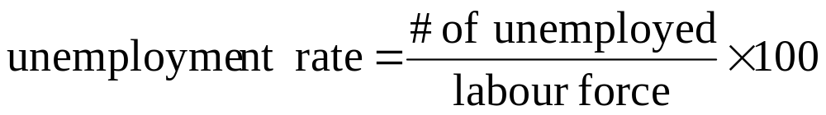
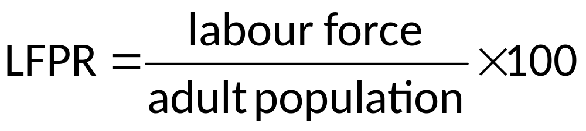

Notes:
Employment rate is NOT = 100 – unemployment rate (b/c diff denominator when calculating those values)
------------------------------------------------------------
Labour force participation rate = LFPR
→ Canana
Employment rate = # of employed/adult population x 100 (NOT 100 – unemployment rate → denominator is different!)
Not in the labour force = people retired, full-time students, stay-at-home parent, able to work but not looking, illegal people, discouraged workers
Not in the adult population = army force, people in prison, mental institution → can’t look for a job even if they wanted to
Adult population = people 15+ of the civilian non-institutionalized population

Slide 4
Statistics Canada’s labour force characteristics (September, 2011)
 | (thousands)
18,733
labour force
unemployed
1334
17, 399
employed
28, 057
adult population
Notes:
Practice calculating labour force participation rate, employment rate, and unemployment rate.
When calculate LFPR, it will be ~67%. This may seem low, but remember talking about everyone from 15+ and 2/3 of those people are either working or unemployed. The remaining 1/3 are either retired, in school full-time or looking after kids at home
LFPR = # in labour force/adult population = 17886.1/26504.5 x 100 = 67%
Unemployment rate = # unemployed/adult population = 1083.6/17886.1 x 100 = 6.06%
Employment rate = # employed/adult population = 16802.5/26504.5 x 100 = 63.4%
People may be retired, or stay at home parents, or 15 yr olds account for the other 23%

Slide 5
Clicker
Tara has justed finished school but she is going to roam around the country awhile before she starts looking for work, as a result, the unemployment rate
  Is unaffected and the labour-force participate rate is unaffected

Slide 6
Do these figures reflect reality?
1. Discouraged workers → unemployment rate understated (worse than actually is)
2. Underemployment →
Unemployment rate understated (people employed but are working less than they want or below their skill level)
Notes:
i.e. When say unemployment rate in Canada is 8%, is that an accurate reflection of how big a problem unemployment really is. This depends…
Discouraged workers are people who were looking for a job, but think that prospect of finding a job is so slim that they have exited labour force. Thus, when Stats Can asks them “are you working?” they say No and when Stats Can asks them “are you looking for a job?” they say No → this means they are not included in the unemployed; they would be counted as being not in the labour force. BUT if given an offer days later, they would gladly take the job. The existence of discouraged workers means that the problem of unemployment may actually be worse than what the figures indicate.
2. Underemployment → can occur in two ways:
Someone working part-time, but would really prefer to be working full-time (30+ hours a week = full-time). Someone working 32h is considered working full-time, but what if individual would really prefer working 40h/wk, we would consider them underemployed.
People working below their skill level (i.e. if you have a software engineer who is laid off and that person goes to become a shift manager at McDonalds)
Both #1 and 2, that the calculated unemployment rate may not be capturing the picture as bad as it really is (reality may be worse).
In the other direction (overestimating number) – may be due to people lying to Stats Can, saying that they are unemployed (actively looking), when they are not actively looking for a job. Lie to collect employment insurance benefits; to collect needs to be actively looking. This means that the unemployment rate value may be over-estimating the unemployment problem
------------------------------------------------------
Discouraged worker = someone who is looking for a job, but can’t get one → give up looking (not included in unemployment rate, but should be b/c if they were given a job, they would take it)
Underemployment = someone working 32, but would like to work 40 (considered full-time). People working part-time, but want full time → People working below skill-level → under-estimation of unemployment
People lying; why would people lie? Collect employment insurance benefits → leading to over-estimation of actual unemployment

Slide 7
Why is there unemployment?
there are three types of unemployment:
1. frictional unemployment
    it takes time for workers to search for a job that suits them the best and time for employers to hire the best workers
2. structural unemployment
    Q of labour supplied > Qof labour demanded
      wage > eq wage
3. cyclical unemployment
    when the economy is in a recession, workers are laid off and vice versa for booms
Notes:
There are three different causes of unemployment:
Cyclical unemployment – unemployment associated with business cycle (i.e. when economy goes into recession, unemployment increases; when economy goes into boom, unemployment decreases). But booms and recession = short run…only deal with long-run for this course
In the long-run, focus is on frictional and structural unemployment.
Frictional – involves people searching (1st type) for work. Occurs b/c you have people entering and leaving labour force (i.e. when graduate from university and spend time looking for career job that would match you = unemployed during that period…this unemployment is good for the economy b/c it allows firms and workers to make a good match with each other.
During Soviet Union, they prided themselves on having zero unemployment in the country – this is b/c gov told people where they were going to work (no matching, no freedom of choice to find a job that is perfect for you). Not good for economy b/c not good matches = not efficient
Frictional employment is good for economy b/c give more efficient outcome and decisions.
Other types of frictional unemployment is when there are sectoral shifts (2nd type) in the economy (i.e. Canada use to be primarily manufacture based and now most GDP is produced from services → sectoral shift; losing manufacturing jobs, gaining service jobs). This is bad for people who become unemployed, but good for the overall economy (i.e. 100 years ago, if people had argued to keep agricultural jobs b/c that is what they are comfortable with, then would not have progressed). Shift in economy can help increase/improve standard of living. (from farming to factories to services, the dying sectors don’t have the skills to get jobs in the rising sectors → they will be umemployed)
Seasonal umployment (3rd type), mismatch b/w jobs available and the type of workesr for the season (can’t do construction in winter)
Employment insurance benefits can also cause frictional unemployment; raises the cost of going to work (i.e. get paid if looking for a job). This is bad for the economy b/c more people would want to stay unemployed and collect EI.
Pro:
- When leaving and entering workforce, looking for the right career (i.e. a graduate)
- Sectoral shifts.
Con: Employment insurance benefits.
Structural unemployment – occurs when wage is higher than eqm wage. This can be due to the government setting a legal minimum (price floor), union (negotiation b/w workers and firms), efficiency wages (firms setting above to attract high-skilled workers).
→ Compared to cyclical booms, structural is based on the wages mainly (labour market not in eqm) and not on demographics
Economy in the long-run
-------------------------------------------------------------
Cyclical unemployment – associated with boom (unemployment decrease) and recession (U increase)
Frictional unemployment – people entering and leaving job (good unemployment rate → worker and firms finding a better match – efficient matching). Sectorial shifts (losing manufacturing, gaining service); economy changes due to change in industries (hard for people unemployed, but may be good for the economy as sectors shift)
Generous employment insurance benefits raises the cost of going to work (getting paid to look for a job)

Slide 8
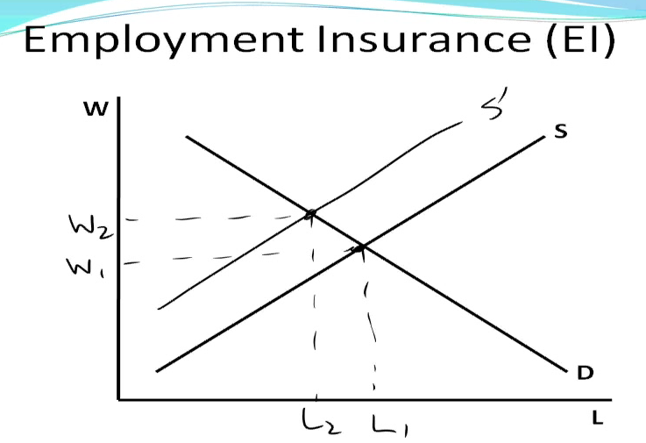
Employment Insurance (EI)
W
S
D
L
Notes:
When go from having no EI to providing EI, the cost of going to work goes up (b/c if don’t go to work, can collect money from the gov – the opp cost of going to work therefore goes up).
Supply curve shifts to the left. Wage increases (W1 to W2, where W = wage). Number of people working decreases (L1 to L2, where L = labour).
Can be good, but not as many people with jobs
→ EI decreases ppl working (because they are getting paid sitting at home, don’t have to waste energy to look for job)

Slide 9
International comparisons
2004
Country | Benefit Replacement (%) | Benefit Duration (years) | Unemployment Rate (%) (2005)
France
Germany
Italy
Spain
UK
US
75
1.92
9.9
69
1
9.4
54
0.5
7.7
67
1.75
9.2
54
0.5
4.8
54
0.5
5.1
Notes:
Benefit replacement in various countries = how much of your previous income from work do you get paid by the gov (i.e. if unemployed in France, you get paid 75% of your wage @ previous job for almost two years).
Thus, the higher the benefit replacement and benefit duration, the higher the unemployment rate. The opportunity cost of going to work increases! As compensation increases, more unemployment.
Benefit duration = how long get to collect that benefit for
i.e. in France, you get 75% of the wage of where you were working before for two years.
i.e. Look at unemployment rates of countries; there is not a perfect correlation, but unemployment rate of France, Germany and Spain (where have generous EI programs) is higher than unemployment rate of UK and US, where unemployment rate not nearly as generous.
---------------------------------------------------------------------------------
Percentage of previous wage that you got when you were unemployment

Slide 10
Between 2001 and 2002, the country of Aquilonia reported an increase in the number of people who were employed. It also reported an increase in the unemployment rate. Which of the following would best exaplain the two reports?
  # umply / # umemply + # emply
  For both umemply and labour force increase to have both employed and unemployment rate increase
  There increase in labour force

Slide 11

ECON 1BB3 – Introduction to Macroeconomics

Slide 12
Review: Why is there unemployment?
there are three types of unemployment:
1. frictional unemployment
2. structural unemployment (wage above eqm)
3. cyclical unemployment
The natural rate of unemployment is the rate of unemployment to which the economy tends to return in the long run. This natural rate consists of frictional and structural unemployment. The natural rate of unemployment differs from country to country.
Notes:
Cyclical unemployment is associated with business cycles. Business cycles happen and unemployment goes above/below depending on whether or not in a recession or boom.
Always have some unemployment and the unemployment that we always tend to return to in the long run is called the natural rate of unemployment. We have this due to frictional and structural unemployment.
----------------------------------------------
The following statement would be viewed as good news in Canada, but bad news in the US: The unemployment rate is 6.5%. What’s going on here?
→ 6.5 is lower than natural rate of unemployment in Canada, but is higher than 6.5 in the US
Don’t graduate during a recession!
Recession: unemployment is higher than usual
Cyclical unemployment causes you to be in either recession or boom. The natural rate of unemployment deals with frictional and structural unemployment.
Structural employment occurs when wage is above equilibrium.
One type of person that can collect EI, while still with a job → paid for a year

Slide 13
1. Minimum wage: economic theory
W
L^{s}
Wmin
L^{d}
L
Notes:
REASONS FOR STRUCTURAL UNEMPLOYMENT
Minimum wage is a price floor – legally binding (has an impact, must be above eqm) price floor. Illegal to pay someone or work for someone lower than the minimum.
If the minimum wage is above eqm wage, the minimum wage is binding b/c it affects what goes on in the market place. When have a binding price floor, Qs > Qd = excess supply/surplus of labour/unemployment.
Unemployment measured by taking the horizontal distance b/w Q of labour supplied and the Q of labour demanded.
If start with binding minimum wage and the minimum wage increases. What happens? Qs increases; Qd decreases = number of people unemployed increases b/c larger horizontal distance at the new higher minimum wage. This argument is usually made by small businesses b/c will say that increasing minimum wage will just increase unemployment in the economy.
BUT when look at real world data, don’t actually find a drop in the number of people working when increase minimum wage. This is because…see next slide.
→ affect unskilled workers
---------------------------------------------------------------------------
Economic theory of the minimum wage
Minimum wage = price floor. A legally mandated minimum – against the law to work for $5/hr.
The price floor is binding if there is a minimum wage and it changes the theory.
Higher minimum wage = more unemployment

Slide 14
Minimum wage: Real world
W
L^{d}
L^{s}
L
Notes:
Vertical labour demand curve. When dealing with minimum wage jobs, usually dealing with low-skilled positions (i.e. running a McDonald’s franchise – will always need a certain amount of workers to run the restaurant; someone cooking, handling money, etc.; thus, regardless of how high minimum wage goes, can’t really cut back on the number of employees when get to a certain point). This is shown by the graph above.
When the minimum wage increases, we technically increase in unemployment b/c at a higher wage, more people want those jobs = the Qs increases BUT the Qd does not decrease (no drop in the number of these jobs even though the wage has gone up). Small business argument is valid to a certain extent – unemployment increases only because more low-skilled workers are willing to work and would therefore increase the number of people wanting to work → there is NO decrease in the demand for quantity of labour.
--------------------------------------------------------------
Increase in minimum wage = do NOT see the number of jobs falling
Most people with these jobs are low-skilled labour.
Mcdonald → even though you automate things, still need people taking cash, burgers, etc.
City with the highest unemployment: Windsor, ON
Natural experiment → raised minimum wage, but no drop in the number of jobs

Slide 15
Minimum wage: market for lawyers
W
L^{s}
400 000
L^{d}
Wmin
L
Notes:
What is the impact of minimum wage legislation on other labour markets (i.e. if not low-skilled labour – market for lawyers).
Minimum wage compared to what lawyers make is set lower than the equilibrium and is therefore not binding and does not affect equilibrium. It is illegal to pay a lawyer less than $8/hr, but lawyers cost $400 000. This means that lawyers won’t become unemployed as a result of the minimum wage legislation.
--------------------------------------
Minimum wage has to be above eqm to be binding. Canada min wage > US min wage.
If someone earning more than minimum wage, would it affect them?

Slide 16
2. Unions
Consider a small town that has one factory and many small businesses. Why would you expect the wage to be the same in both industries?
Notes:
Another factor that contribute to structural unemployment = unions.
Union is a group of workers who band together and try to bargain for higher wages from the firm. They have power using the threat to strike. If the workers strike, firm makes no product and therefore no profits.
Why is the wage the same b/w the factory and small businesses?
----------------------------------------
Question is end-of-chapter.
What would happen if the wage wasn’t the same in both industries?
Smaller industry > factory → people switch from factory to industry, but eventually…industry wage is driven down and factory wage is driven up.
→ It would be the same because or else, ppl will shift to the side with higher wage (get a shortage of the other industry)

Slide 17
Factory
Small businesses
W
L^{s}
W
L^{s}
L^{d}
L^{d}
L
L
Notes:
In both graphs, the wage is the same.
If wage was higher in one sector, more workers would enter that sector and drive the wage down and drive the wage in the other sector up. This explains why the wages start out the same (W1).
Suppose workers in the factory unionize. What happens?
-------------------------------------------------------------------------
Union is a group of workers who band together to get the firm to pay them higher wages.
Threat to strike. Strike = firm can’t make things = decrease profit.
New union wage is always higher than non-union economy. Unions cause unemployment (some may go back to school, sit home, etc.)
Unemployed people will leave sector and enter a new one

Slide 18
Now suppose workers in the factory form a union.
What happens?
Factory
Small businesses
W
L^{s}
W
L^{s}
L^{d}
L^{d}
L
L
Notes:
If the workers convince the firm to pay them a higher wage, the wage is above eqm in the factory. Qs > Qd; when most union contracts are written, there is a provision in the contract to protect jobs, but if you think about what the firm does over time, they would probably try not to hire more workers as they increase output and have workers just produce more stuff. At some point, the firm will cutback on workers.
In the factory sector, there is unemployment. Some of these workers will go look for jobs in the other sector (small businesses). This causes the Ls curve to shift out to the right; Wn = wage for the non-union sector and Wu = wage for the union sector. Union wages are higher than non-union wages. (there is a big gap b/w surplus line for factory and new eq line for small businesses → union workers usually get paid higher)
--------------------------------------

Slide 19
3. Efficiency wages
firms operate more efficiently by increased worker productivity if wages are above equilibrium level
1. Worker Health – nutritious diet means workers are more productive (not applicable to firms in rich countries like Canada)
2. Worker Turnover – less of an incentive for the workers to leave if the firm is paying more than its competitors
3. Worker Effort – reduces shirking among workers
4. Worker Quality – attracts a better and more qualified pool of workers
Notes:
Efficiency wages also cause structural unemployment.
Efficiency wages states that firms may operate more efficiently if firms offer a higher than equilibrium wage. There are 4 reasons why this is true.
Worker Health – only true in poor countries; their eqm wages are so low that it doesn’t provide a healthy diet for workers. If you increase their pay, they can actually afford to eat enough calories to be productive workers. This is not the case in developed countries.
But offering a higher than eqm wage still an argument for developed countries in that:
Worker Turnover (expenses for firms like hiring new ppl or train workers)– will decrease – fewer people leaving; it costs money to hire and train new employees. Profitability may increase.
Worker Effort – workers will work harder b/c don’t want to get fired. If get fired, they will earn a lower wage at a competing firm. (REDUCE SHIRKING → being lazy)
Worker Quality – atrract better applcants for the job if the wage is higher
When workers are looking for a job, they have a reservation wage. The minimum wage they are willing to accept in order to take a position. Reservation wage of each person depends on things only the worker knows (i.e. how hard working they are, how intelligent they are). Someone who is a hard worker and very smart is likely to have a higher reservation wage than someone who is lazy and not so smart. If the firm offers a wage that is higher than the high quality worker’s reservation wage then both workers will apply for the job. The firm stands a chance of getting the high quality worker.
→ Better to have the higher wage for the smart ppl because if you don’t, only less-skille dppl will apply. If you do give the high wage, both parties will apply and you have a 50:50 change of getting the skilled guy
If the wage that the firm is offering is only higher than the low quality worker’s wage, then only the low quality worker applies for the job. This idea of efficiency wages was first introduced by Henry Ford when he started offering $5/day to work in his factory. Henry Ford is known for introducing the assembly line method of production. There is a reason why efficiency wages were first introduced to an assembly line setting.
Prior the introduction of an assembly line, you would have one group of workers building a car in one corner of the factory from start to finish and another group building another car. If one member was sick, then the rest of the group members could work on building the car OR it was only the production of one car put in jeopardy. When there is an assembly line, however, you have the car moving along and if first worker in the assembly line is sick, then the entire assembly line is stopped. Henry Ford figured that if he paid them higher than eqm wage (he paid them double the going rate), then his workers would work harder, wouldn’t quit as much, wouldn’t be sick as often. This made his profits increase.
---------------------------------------------------------------

Slide 20
W
L^{s}
Weff
L^{d}
L
Notes:
Efficiency wage is a wage that is above eqm that the firm decides to pay b/c they think that it will increase their productivity and profitability.
All three cases (minimum wage, union, efficiency wage) are about the same. Wage is higher than eqm, which results in a surplus of workers, resulting in unemployment. Difference is what the driving force is behind each of these three causes of structural unemployment.
Minimum wage = government that is causing the wage to be higher than eqm.
Union = workers are causing higher wage
Efficiency wages = firm causing higher wage.
Same diagram and same result, but with different people causing structural unemployment.
----------------------------------------------
Graphs look the same, but driving force causing this pattern is different.
Minimum wage = government
Union = people
Efficiency wage = firms
Chapter 8 and 9 have been two lectures each. 2nd lecture of chapter 8 = lots of models = KNOW!!! Know how to use, how do you get to eqm, what happens if shift, etc.
-→ in an assembly line, one person missing work will affect the entire assembly line, thus he had eficientcy wages (doubled the wages, and actualy doubled profit(

